Slide 1
Explore fundamental concepts in algorithms and data structures.
Module 1: Introduction to Algorithms
Week 1
Understand core data structures and their operations.
Module 2: Basic Data Structures
Week 2
Discover basic sorting techniques and performance analysis.
Module 3: Sorting Algorithms P1
Week 3
Examine advanced sorting methods and efficiency improvements.
Module 4: Sorting Algorithms P2
Week 4
Learn fundamental searching algorithms for data retrieval.
Module 5: Searching Algorithms P1
Week 5
Explore advanced search structures and optimization strategies.
Module 6: Searching Algorithms P2
Week 6
Public Holiday
Week 7
No class scheduled due to a public holiday.
Grasp basic graph theory and traversal techniques.
Module 7&8: Graph Algorithms P1
Week 8
Dive into advanced graph algorithms, including shortest path methods.
Module 9: Graph Algorithms P2
(lecture on Tuesday)
Week 9
Learn dynamic programming techniques to solve optimization problems efficiently.
Module 10: Dynamic Programming
Week 10
Explore efficient techniques for string processing and pattern matching.
Module 11: String Algorithms
Week 11
Notes:
In this module, we will explore Dynamic Programming (DP), a powerful technique used to solve complex problems by breaking them down into simpler subproblems, and apply it to two key problems in string matching: the Longest Common Subsequence (LCS) and Minimum Edit Distance (MED).

Slide 2
Module 10: Dynamic programming
Note: Some of these slides have been adapted from
slides freely available on the Internet and also from the
slides accompanying the course textbook.
Notes:
In this module, we will explore Dynamic Programming (DP), a powerful technique used to solve complex problems by breaking them down into simpler subproblems, and apply it to two key problems in string matching: the Longest Common Subsequence (LCS) and Minimum Edit Distance (MED).

Slide 3
Revise previous module
Graph Representation: Use adjacency lists (for sparse graphs) or matrices (for dense graphs), with directed or undirected edges.
Traversal:
BFS: Finds shortest unweighted paths.
DFS: Detects cycles.
Shortest Path:
Dijkstra’s: For non-negative weights.
Bellman-Ford: Handles negative weights.
Topological Sort: Orders nodes in a Directed Acyclic Graph (DAG) for scheduling tasks.
Applications: Social networks, routing, and task scheduling.
Notes:
Graph Representation:
Adjacency List vs. Matrix: Different ways to represent graphs, with the adjacency list being more space-efficient for sparse graphs, and the adjacency matrix providing faster edge lookup for dense graphs.
Directed vs. Undirected Graphs: In directed graphs, edges have a direction, while in undirected graphs, the edges are bidirectional.
Graph Traversal:
BFS (Breadth-First Search): Explores the graph level by level, useful for finding the shortest unweighted path.
DFS (Depth-First Search): Explores deeply into the graph, which is helpful for detecting cycles and other properties.
Shortest Path Algorithms:
Dijkstra’s Algorithm: Solves for the shortest path in graphs with non-negative weights using a priority queue. It ensures that each node is visited in order of increasing distance from the start node.
Bellman-Ford Algorithm: A more robust algorithm that works even with negative edge weights.
Topological Sorting:
Used for ordering vertices in a Directed Acyclic Graph (DAG). Topological sorting is vital for applications like task scheduling, where certain tasks must precede others.
Applications:
Social Networks: Graph algorithms help in analyzing relationships and finding shortest paths between individuals.
Routing: Algorithms like Dijkstra’s are used in GPS and network routing.
Task Management: Topological sorting is crucial for scheduling tasks based on dependencies.

Slide 4
Learning outcomes
After completing this module, you will be able to:
Understand the principle of Dynamic Programming as a method to solve complex problems
Recognize the concept and significance of the Longest Common Subsequence problem
Outline the steps to determine the Minimum Edit Distance between two strings
Notes:
After completing this module, you will be able to:
Understand Dynamic Programming as a method to solve complex problems.
DP helps in breaking down complex problems into simpler subproblems, solving them, and using the results to build up a solution for the original problem.
Recognize the Longest Common Subsequence Problem (LCS)
LCS is about finding the longest sequence of characters that appears in both strings, maintaining the order but not necessarily consecutively.
Outline the Minimum Edit Distance Problem
Learn how to determine the minimum number of operations (insertions, deletions, or substitutions) required to convert one string into another.

Slide 5
Module Topics
Dynamic Programming
Longest Common Subsequence Problem
Minimum Edit Distance Problem
Notes:
In this module, we will cover the following topics:
Dynamic Programming (DP)
Understanding the concept and applications of DP.
Longest Common Subsequence Problem (LCS)
Explore the importance and solution for the LCS problem.
Minimum Edit Distance Problem
Learn how to calculate the minimum edit distance between two strings.

Slide 6
Dynamic Programming (DP) Algorithm
Based on remembering past results
Approach
Divide problem into smaller subproblems
Subproblems must be of same type
Subproblems must overlap
Solve each subproblem recursively
May simply look up solution
Combine solutions to solve original problem
Store solution to problem
Generally applied to optimization problems
Topic: Dynamic programming algorithms
Notes:
Dynamic programming is based on remembering past results. Here's how DP works:
Divide the problem into smaller subproblems:
The subproblems must be of the same type and should overlap.
Solve each subproblem recursively:
You may simply look up the solution for previously solved subproblems to avoid redundant work.
Combine solutions to solve the original problem:
By combining the results of subproblems, you obtain the solution to the overall problem.
Store solutions to subproblems:
This avoids recomputing solutions for the same subproblems, thus improving efficiency.

Slide 7
DP Example - Fibonacci Algorithm
Fibonacci numbers
fibonacci(0) = 1
fibonacci(1) = 1
fibonacci(n) = fibonacci(n-1) + fibonacci(n-2)
Recursive algorithm to calculate fibonacci(n)
If n is 0 or 1, return 1
Else compute fibonacci(n-1) and fibonacci(n-2)
Return their sum
Simple algorithm ⇒ exponential time O(2^{n})
Topic: Dynamic programming algorithms
Notes:
Let’s look at how dynamic programming can optimize a common problem: the Fibonacci sequence.
Fibonacci Numbers:
fibonacci(0) = 1
fibonacci(1) = 1
fibonacci(n) = fibonacci(n-1) + fibonacci(n-2)
Recursive Algorithm:
To calculate fibonacci(n), the algorithm checks if n is 0 or 1, returning 1. Otherwise, it computes fibonacci(n-1) and fibonacci(n-2), then returns their sum.
Efficiency:
The naive recursive approach results in exponential time complexity O(2^n), because it recalculates the same values multiple times.

Slide 8
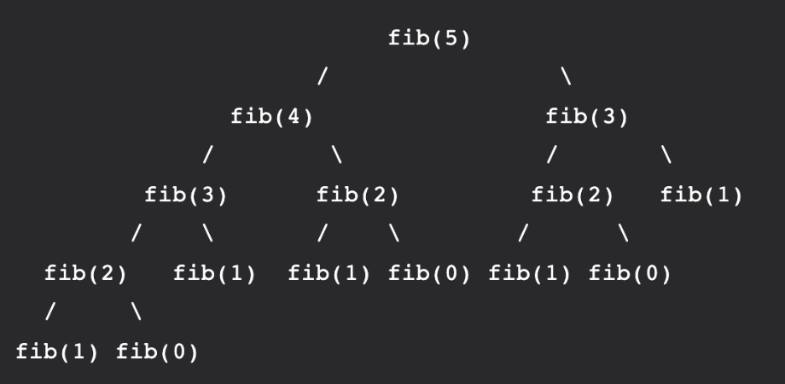
Dynamic Programming - Example
Recursion approach: Let’s start with recursion approach first to see how repetitive the calculation could be.
Code:
def Fib(n):
if n <= 1:
return n
return Fib(n-1) + Fib(n-2)
0
1
1
2
3
5
8
0
1
2
3
4
5
6
So now we need to calculate Fib(5) and Fib(8). Let’s focus on calculating Fib(5) for now. When we call Fib(5), it starts recursing (going down) to smaller values, which is Fib(4) + Fib(3). It keeps recursing until we reach the base case when n <=1. We can visualize Fib(5) by drawing this:
Topic: Transform and conquer algorithms
Notes:
2
Let’s start with recursion to calculate Fibonacci numbers and see how repetitive the calculations can be.
Explanation:
We need to calculate Fib(5) and Fib(8), but let’s focus on Fib(5) for now.
When we call Fib(5), it starts breaking down into smaller values like Fib(4) and Fib(3).
This process continues recursively until reaching the base case (Fib(0) or Fib(1)).
Visual:
The picture shows the recursive breakdown. We see how Fib(5) calls Fib(4) and Fib(3), and this continues down further.
Key Point: This method repeats calculations and is inefficient because it recalculates the same values multiple times.

Slide 9

Dynamic Programming
0
1
1
2
3
5
8
0
1
2
3
4
5
6
Code:
def Fib(n):
if n <= 1:
return n
return Fib(n-1) + Fib(n-2)
We can see that there are many repeated calculations such as fib(3) and fib(2), which are circled on the picture above. So, we are wasting time to calculate things that we already got the result → It is better if we can store the calculated values somewhere and reuse it later.
→ Solution: Dynamic programming!
Topic: Transform and conquer algorithms
Notes:
2
The recursive approach leads to redundant calculations.
Explanation:
In the image, we can see that Fib(3) and Fib(2) are recalculated multiple times.
This leads to wasted time since we are calculating things that we already know the result of.
Solution:
Dynamic Programming is the solution: instead of recalculating, we store the results and reuse them, improving efficiency.

Slide 10
Dynamic Programming
Code for dynamic programming:
def fibonacci(n):
# Taking 1st two fibonacci numbers as 0 and 1
f = [0, 1]
for i in range(2, n+1):
f.append(f[i-1] + f[i-2])
return f[n]
Let’s walk through step-by-step to get the ideas of using Dynamic Programming.
1. Initialize f with 0 and 1
f =
0
1
Topic: Transform and conquer algorithms
Notes:
2
Let’s now switch to Dynamic Programming to solve Fibonacci more efficiently.
Explanation:
We start by initializing a list f with the first two Fibonacci numbers, 0 and 1. These values serve as the foundation of the sequence.
Visual:
The picture shows the list f being initialized with [0, 1]. These are the base cases of the Fibonacci sequence.
Key Point: These base values provide the starting point for building the Fibonacci sequence.

Slide 11
Dynamic Programming
Code for dynamic programming:
def fibonacci(n):
# Taking 1st two fibonacci numbers as 0 and 1
f = [0, 1]
for i in range(2, n+1):
f.append(f[i-1] + f[i-2])
return f[n]
Let’s walk through step-by-step to get the ideas of using Dynamic Programming.
2. Within the first loop, we append the list with f[2-1] + f[2-2]. When we do that operation (i.e., append), we actually store the values of f[2-1] + f[2-2] to our list at index 2, so we can use later.
0
1
f =
0
1
1
1
Topic: Transform and conquer algorithms
Notes:
2
Let’s calculate the next Fibonacci number using Dynamic Programming.
Explanation:
In the first step, we calculate Fib(2) by adding Fib(1) and Fib(0) from the list.
We store this result in the list.
Visual:
The list f becomes [0, 1, 1] after calculating Fib(2).
Key Point: By storing the result, we avoid recalculating Fib(1) and Fib(0) again.

Slide 12
Dynamic Programming
Code for dynamic programming:
def fibonacci(n):
# Taking 1st two fibonacci numbers as 0 and 1
f = [0, 1]
for i in range(2, n+1):
f.append(f[i-1] + f[i-2])
return f[n]
Let’s walk through step-by-step to get the ideas of using Dynamic Programming.
3. Similarly, we append the list with f[3-1] + f[3-2]. When we append, we store the values of f[3-1] + f[3-2] to our list, so we can use later. If you notice, we are using f[2-1] + f[2-2] from the previous step to calculate f[3-1].
0
1
2
f =
0
1
1
2
2
f[3-1] = f[2-1] + f[2-2]
Topic: Transform and conquer algorithms
Notes:
2
Now, let’s continue building the sequence.
Explanation:
To calculate Fib(3), we add Fib(2) and Fib(1), both of which are already in the list.
This keeps the process efficient, as we are using previously computed values.
Visual:
The list f becomes [0, 1, 1, 2] after calculating Fib(3).
Key Point: By reusing stored values, we avoid redundant calculations and keep the process efficient.

Slide 13
Dynamic Programming
Code for dynamic programming:
def fibonacci(n):
# Taking 1st two fibonacci numbers as 0 and 1
f = [0, 1]
for i in range(2, n+1):
f.append(f[i-1] + f[i-2])
return f[n]
Let’s walk through step-by-step to get the ideas of using Dynamic Programming.
4. Similarly, we append the list with f[4-1] + f[4-2]. We are using f[3-1] + f[3-2] from the previous step to calculate f[4-1]; and f[2-1] + f[2-2] to calculate f[4-2]
0
1
2
3
f =
0
1
1
2
3
f[4-1] = f[3-1] + f[3-2] = index 2 + index 1 = 2
+
f[4-2] = f[2-1] + f[2-2] = index 1 + index 0 = 1
3
Topic: Transform and conquer algorithms
Notes:
2
We continue applying the same method to calculate the next Fibonacci numbers.
Explanation:
For Fib(4), we add Fib(3) and Fib(2), which are already in the list.
The list keeps growing as we calculate and store each Fibonacci number.
Visual:
The list f becomes [0, 1, 1, 2, 3] after calculating Fib(4).
Key Point: The list grows with each new Fibonacci number, and the previously calculated values are used for future calculations.

Slide 14
Dynamic Programming
Code for dynamic programming:
def fibonacci(n):
# Taking 1st two fibonacci numbers as 0 and 1
f = [0, 1]
for i in range(2, n+1):
f.append(f[i-1] + f[i-2])
return f[n]
Let’s walk through step-by-step to get the ideas of using Dynamic Programming.
5. Similarly, we append the list with f[5-1] + f[5-2]. We are using f[4-1] + f[4-2] from the previous step to calculate f[5-1]; and f[3-1] + f[3-2] to calculate f[5-1]
0
1
2
3
4
f =
0
1
1
2
3
5
f[5-1] = f[4-1] + f[4-2] = index 3 + index 2 = 4
+
f[5-2] = f[3-1] + f[3-2] = index 2 + index 1 = 1
5
Topic: Transform and conquer algorithms
Notes:
2
Let’s continue with the next Fibonacci numbers.
Explanation:
For Fib(5), we add Fib(4) and Fib(3), both of which are already in the list.
The result is stored, and the process continues.
Visual:
The list f becomes [0, 1, 1, 2, 3, 5] after calculating Fib(5).
Key Point: We continue to build the sequence by using previously calculated values.

Slide 15
Dynamic Programming
Code for dynamic programming:
def fibonacci(n):
# Taking 1st two fibonacci numbers as 0 and 1
f = [0, 1]
for i in range(2, n+1):
f.append(f[i-1] + f[i-2])
return f[n]
Let’s walk through step-by-step to get the ideas of using Dynamic Programming.
6. We do similar process to index 6 (=8), now we can calculate the index n+1 in the loop. After that, we achieved sum of last two n-th Fibonacci Number, which is also the next Fibonacci number.
0
1
2
3
4
5
6
f =
0
1
1
2
3
5
8
13
13
Topic: Transform and conquer algorithms
Notes:
2
Now, let’s discuss the time complexity of Dynamic Programming.
Explanation:
In recursion, the time complexity is O(2^n), as the function recalculates the same values multiple times.
With Dynamic Programming, we calculate each Fibonacci number only once, and the time complexity becomes O(n).
Key Point: Dynamic Programming drastically reduces the time needed to compute Fibonacci numbers by reusing previous results.

Slide 16
Dynamic Programming
Code for dynamic programming:
def fibonacci(n):
# Taking 1st two fibonacci numbers as 0 and 1
f = [0, 1]
for i in range(2, n+1):
f.append(f[i-1] + f[i-2])
return f[n]
Overall, this way only takes O(n) of time complexity since we only pass through n elements once. It is much faster than the recursive algorithm and more efficient since we saved the calculation of previous Fib to use in later calculation.
0
1
2
3
4
5
6
f =
0
1
1
2
3
5
8
13
13
Topic: Transform and conquer algorithms
Notes:
2
Overall, Dynamic Programming is a much faster and more efficient method compared to the recursive approach.
Explanation:
The process takes linear time O(n)O(n)O(n) because we only calculate each Fibonacci number once and store it for later use.
By storing previous results, we avoid redundant calculations and make the process significantly more efficient.
Visual:
The final list f shows all Fibonacci numbers from Fib(0) to Fib(8).

Slide 17
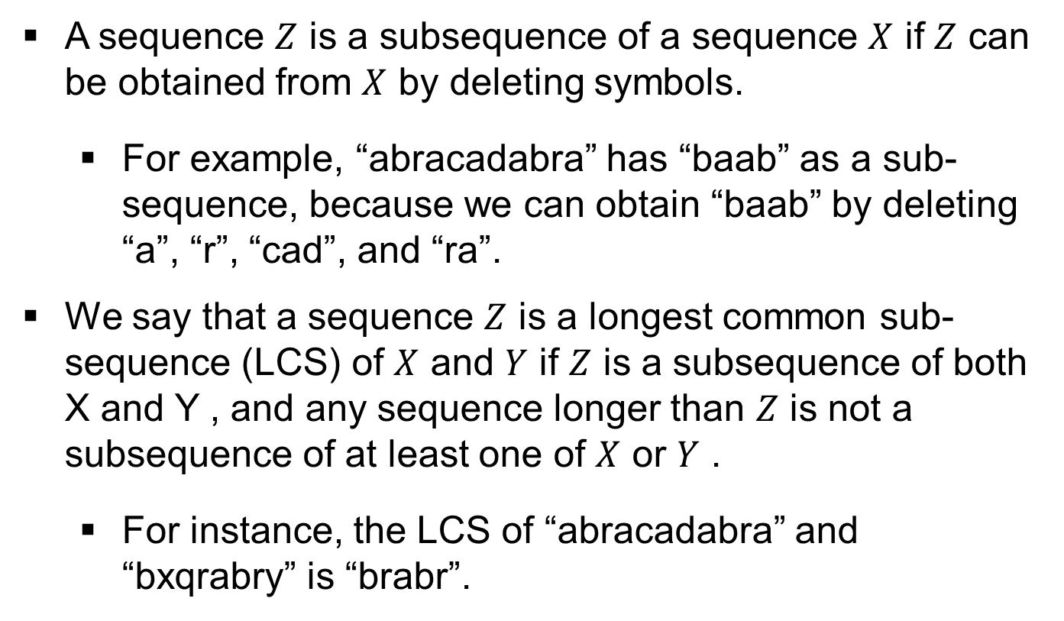
Longest Common Subsequence Problem
A sequence $Z$ is a subsequence of a sequence $X$ if $Z$ can be obtained from $X$ by deleting symbols.
For example, “abracadabra” has “baab” as a sub-sequence, because we can obtain “baab” by deleting “a”, “r”, “cad”, and “ra”.
We say that a sequence $Z$ is a longest common sub-sequence (LCS) of $X$ and $Y$ if $Z$ is a subsequence of both X and Y , and any sequence longer than $Z$ is not a subsequence of at least one of $X$ or $Y$ .
For instance, the LCS of “abracadabra” and “bxqrabry” is “brabr”.
Topic: LCS Problem
Notes:
The Longest Common Subsequence (LCS) is a problem where we aim to find the longest sequence that is a subsequence of both strings.
Explanation:
A sequence Z is a subsequence of sequence X if Z can be obtained from X by deleting symbols (without reordering).
Example: For X = "abracadabra", a valid subsequence is "baab" (you can delete "a", "r", "cad", and "ra" to get "baab").
LCS is the longest subsequence that exists in both sequences.

Slide 18
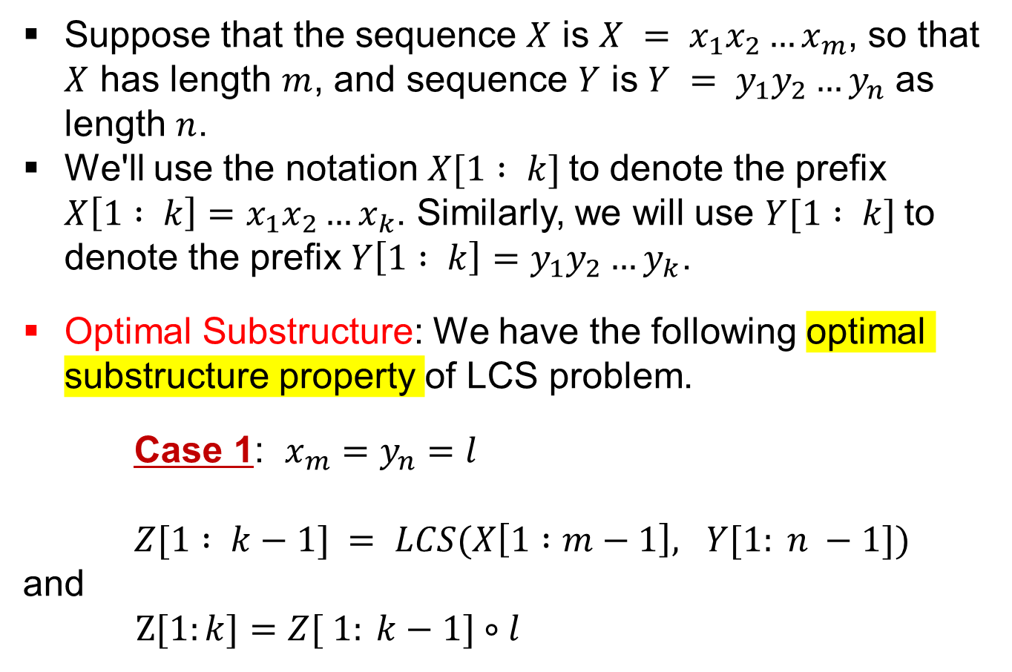
Longest Common Subsequence Problem (Contd.)
Suppose that the sequence $X$ is $X = x_{1}x_{2}…x_{m}$, so that $X$ has length $m$, and sequence $Y$ is $Y = y_{1}y_{2}…y_{n}$ as length $n$.
We'll use the notation $X[1 : k]$to denote the prefix $X\left[1 : k\right]=x_{1}x_{2}…x_{k}$. Similarly, we will use $Y[1 : k]$to denote the prefix $Y\left[1 : k\right]=y_{1}y_{2}…y_{k}$.
Optimal Substructure: We have the following optimal substructure property of LCS problem.
Case 1: $x_{m}=y_{n}=l$
$Z[1 : k−1] = LCS(X\left[1 :m−1\right], Y[1: n −1])$
and
$Z[1:k]=Z[ 1: k−1]∘l$
Topic: LCS Problem
Notes:
Let’s now discuss the optimal substructure property of the LCS problem.
Explanation:
Suppose X has length m and Y has length n.
We use the notation X[1:k] for the prefix of X, which is x1x2...xk, and similarly Y[1:k] for Y's prefix.
Optimal Substructure:
If the last characters of X and Y match (xm = yn), then the LCS of X and Y includes that last character.
If xm ≠ yn, the LCS is the longer subsequence from either X[1:m-1] or Y[1:n-1].
Key Point: The problem can be broken down into smaller subproblems, which we solve recursively.

Slide 19
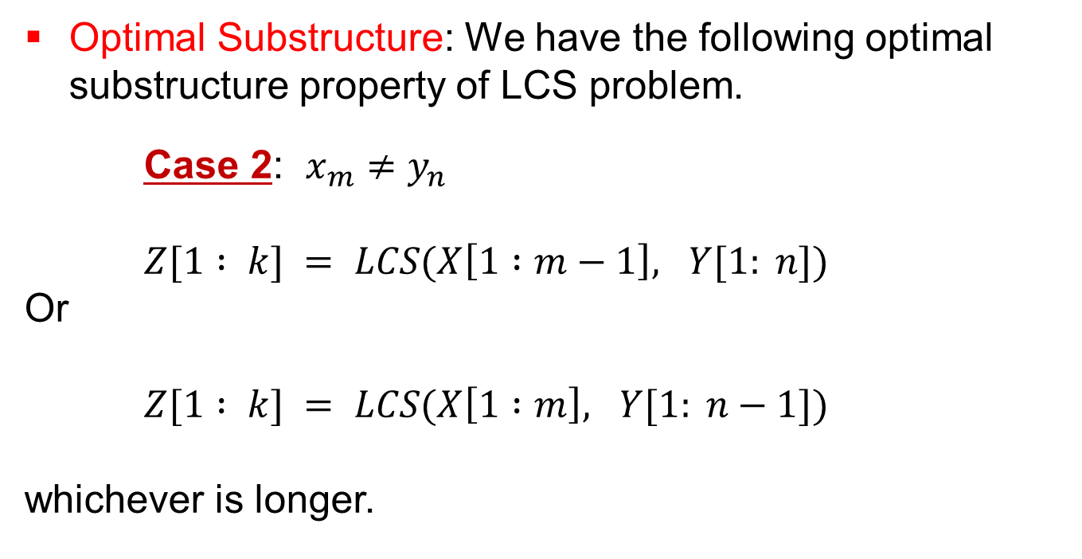
Longest Common Subsequence Problem (Contd.)
Optimal Substructure: We have the following optimal substructure property of LCS problem.
Case 2: $x_{m}≠y_{n}$
$Z[1 : k] = LCS(X\left[1 :m−1\right], Y[1: n])$
Or
$Z[1 : k] = LCS(X\left[1 :m\right], Y[1: n−1])$
whichever is longer.
Topic: LCS Problem
Notes:
Let’s look at Case 2 of the optimal substructure property.
Explanation:
If the last characters of X and Y don’t match (xm ≠ yn), we find the LCS of either X[1:m-1], Y[1:n] or X[1:m], Y[1:n-1].
We choose the subsequence that is longer.
Key Point: This case allows us to discard the current character and continue solving for the longest subsequence.

Slide 20
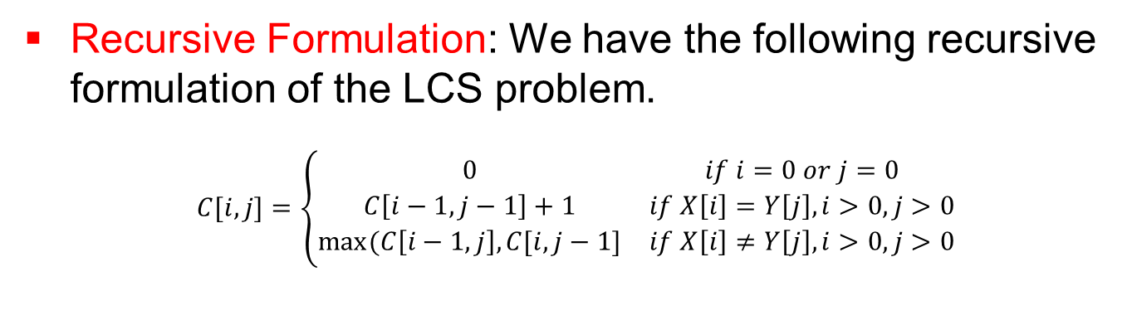
Longest Common Subsequence Problem (Contd.)
Recursive Formulation: We have the following recursive formulation of the LCS problem.
$$C[i, j]=\left\{\begin{matrix}0 & if i=0 or j=0 \\ C\left[i−1, j−1\right]+1 & if X\left[i\right]=Y\left[j\right], i>0, j>0 \\ max⁡(C\left[i−1, j\right], C[i, j−1] & if X\left[i\right]≠Y\left[j\right], i>0, j>0\end{matrix}\right.$$
Topic: LCS Problem
Notes:
We can define the recursive formulation of the LCS problem as follows.
Explanation:
The recursive function C[i, j] helps calculate the LCS of the prefixes of X and Y.
The recursive cases are:
If i = 0 or j = 0, C[i, j] = 0 (base case).
If X[i] = Y[j], C[i, j] = C[i-1, j-1] + 1.
If X[i] ≠ Y[j], C[i, j] = max(C[i-1, j], C[i, j-1]).
Key Point: This recursive relation calculates the LCS by considering all possible subsequences and choosing the optimal one.

Slide 21
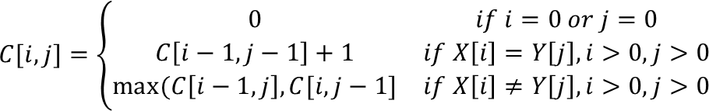
Longest Common Subsequence Problem (Contd.)
The LCS Table:
 | # | a | b | c | d | a | f
# | 0 | 0 | 0 | 0 | 0 | 0 | 0
a | 0
c | 0
b | 0
c | 0
f | 0
Topic: LCS Problem
Notes:
Let’s initialize the LCS Table.
Explanation:
The LCS table C is a 2D array where C[i,j] represents the length of the LCS of the prefixes X[1:i] and Y[1:j].
The table starts by setting the first row and column to 0 because the LCS of an empty string and any string is 0.
Visual:
The table shows the initial values where C[i,0] = 0 and C[0,j] = 0.

Slide 22
Longest Common Subsequence Problem (Contd.)
The LCS Table:
 | # | a | b | c | d | a | f
# | 0 | 0 | 0 | 0 | 0 | 0 | 0
a | 0 | 1
c | 0
b | 0
c | 0
f | 0
Topic: LCS Problem
Notes:
Now, we will start filling the LCS table.
Explanation:
We check whether each pair of characters in X and Y match. If they do, we increment the previous diagonal value by 1. If they don’t match, we take the maximum of the values from the left or top.
For example, C[a, b] = 1 because a = b.
Visual:
The table shows the updated value for C[a,b] = 1, indicating the first common character.

Slide 23
Longest Common Subsequence Problem (Contd.)
The LCS Table:
 | # | a | b | c | d | a | f
# | 0 | 0 | 0 | 0 | 0 | 0 | 0
a | 0 | 1
c | 0
b | 0
c | 0
f | 0
Topic: LCS Problem
Notes:
We continue updating the LCS table.
Explanation:
As we go row by row, we continue checking for matches and updating the table.
For example, C[c,b] = 1 because c ≠ b, and we take the maximum from the top and left values.
Visual:
The table continues to fill out, showing the intermediate values of the LCS.

Slide 24
Longest Common Subsequence Problem (Contd.)
The LCS Table:
 | # | a | b | c | d | a | f
# | 0 | 0 | 0 | 0 | 0 | 0 | 0
a | 0 | 1 | 1 | 1 | 1 | 1 | 1
c | 0 | 1 | 1 | 2 | 2 | 2 | 2
b | 0 | 1 | 2 | 2 | 2 | 2 | 2
c | 0 | 1 | 2 | 3 | 3 | 3 | 3
f | 0 | 1 | 2 | 3 | 3 | 3 | 4
LCS=“abcf”
Topic: LCS Problem
Notes:
The table is now complete. Let’s look at the final LCS result.
Explanation:
The arrows show the path taken to fill the table, and the longest common subsequence "abcf" can be read off from the table starting from the bottom-right corner.
This is the final result of the LCS problem.
Key Point: The longest subsequence is constructed by tracing back through the table.

Slide 25
Longest Common Subsequence Problem (Contd.)
Recovering the actual LCS.
Topic: LCS Problem
Notes:
Finally, let’s look at the algorithm to recover the actual LCS from the table.
Explanation:
The algorithm starts from the bottom-right of the LCS table.
It traces back the characters that are part of the LCS, appending them to a list L.
If characters match (X[i] = Y[j]), they are added to the list. If they don’t match, the algorithm moves in the direction of the larger value (either left or up in the table).

Slide 26
Minimum Edit Distance Problem
How similar are two strings?
Spell correction
The user typed “graffe”
Which is closest?
graf
grab
grail
giraffe
Computational Biology
Align two sequences of nucleotide
AGGCTATCACCTGACCTCCAGGCCGATGCCC
TAGCTATCACGACCGCGGTCGATTTGCCCGAC
Also for Machine Translation, Information Extraction, Speech Recognition
Topic: MED Problem
Notes:
How similar are two strings?
Spell correction: For example, the user typed "graffe," which may need correction to "graf," "grail," or "giraffe."
Computational Biology: This is commonly used to align two sequences of nucleotides. For instance, given the sequences "AGGCT" and "TAGCT," the task is to find the most similar sequence, such as "TAGCT."
Additional Use Cases:
Machine Translation
Information Extraction
Speech Recognition

Slide 27
Minimum Edit Distance Problem (Contd.)
Edit Distance
The minimum edit distance between two strings
Is the minimum number of editing operations
Insertion
Deletion
Substitution
Needed to transform one into the other.
Topic: MED Problem
Notes:
Edit Distance is the minimum number of operations needed to transform one string into another. The allowed operations are:
Insertion: Add a character.
Deletion: Remove a character.
Substitution: Replace one character with another.
This metric is crucial for tasks like spell checking and biological sequence alignment.

Slide 28
Minimum Edit Distance Problem (Contd.)
Edit Distance
Why would we Add weights to the computation?
Spell Correction: some letters are more likely to be mistyped than others.
Biology: certain kinds of deletions or insertions are more likely than others
If each operation has cost of 1
Distance between these is 5
If substitutions cost 2 (Levenshtein)
Distance between them is 8
Topic: MED Problem
Notes:
Consider transforming the word "INTENTION" to "EXECUTION".
Operation cost: Each operation (insertion, deletion, substitution) is assumed to cost 1.
If substitutions have a higher cost (e.g., 2 instead of 1), it will affect the minimum distance calculation, as seen in biological contexts (Levenshtein distance).
Use case for weights:
Spell correction: Some letters (e.g., 'o' and 'i') are more likely to be mistyped than others.
Biology: Some nucleotide changes (insertions or deletions) are more common than others.

Slide 29
Minimum Edit Distance Problem (Contd.)
How to find the Min Edit Distance?
Searching for a path (sequence of edits) from the start string to the final string:
Initial state: the word we’re transforming
Operators: insert, delete, substitute
Goal state: the word we’re trying to get to
Path cost: what we want to minimize: the number of edits
Topic: MED Problem
Notes:
The goal is to transform a word into another by editing it.
Initial state: The word you're starting with.
Goal state: The word you're trying to reach.
Operations: Insert, delete, or substitute.
Path cost: The number of edits it takes to reach the goal state.

Slide 30
Minimum Edit Distance Problem (Contd.)
Minimum Edit as Search
The space of all edit sequences is huge!
We can’t afford to navigate naïvely
Lots of distinct paths wind up at the same state.
We don’t have to keep track of all of them.
Just the shortest path to each of those revisited states.
Topic: MED Problem
Notes:
Minimum Edit as Search: The space of all possible edit sequences is enormous.
Why is this important? We don't need to explore all possible sequences—only the shortest path to reach the final state.
Distinct paths: Multiple paths may lead to the same state, but only the shortest path matters.

Slide 31
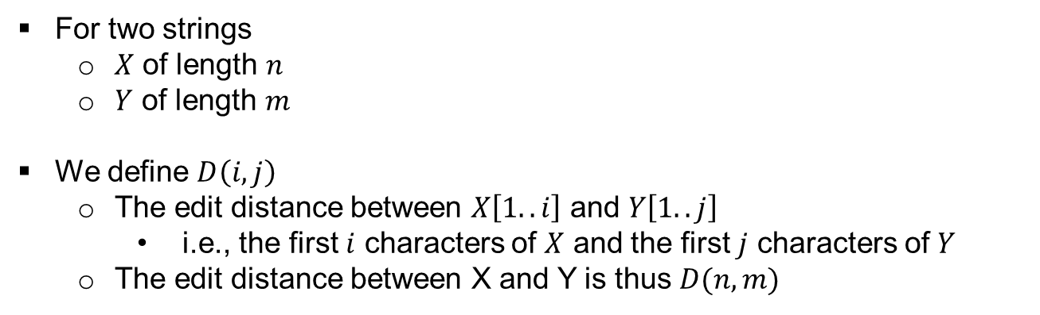
Minimum Edit Distance Problem (Contd.)
Defining Min Edit Distance
For two strings
$X$ of length $n$
$Y$ of length $m$
We define $D\left(i, j\right)$
The edit distance between $X\left[1..i\right]$ and $Y\left[1..j\right]$
i.e., the first $i$ characters of $X$ and the first $j$ characters of $Y$
The edit distance between X and Y is thus $D(n, m)$
Topic: MED Problem
Notes:
For two strings X and Y:
X has length n and Y has length m.
We define D(i, j) as the edit distance between the first i characters of X and the first j characters of Y.
D(n, m) is the minimum edit distance between X and Y.

Slide 32
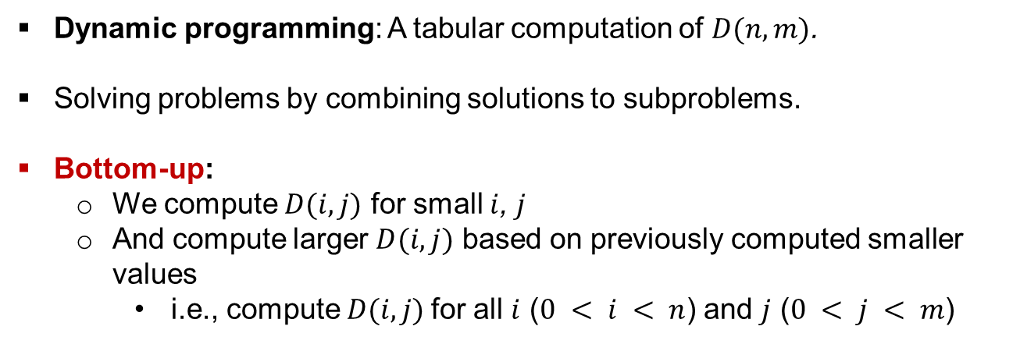
Minimum Edit Distance Problem (Contd.)
Dynamic Programming for Minimum Edit Distance
Dynamic programming: A tabular computation of $D(n, m)$.
Solving problems by combining solutions to subproblems.
Bottom-­up:
We compute $D(i, j)$ for small $i$, $j$
And compute larger $D(i, j)$ based on previously computed smaller values
i.e., compute $D(i, j)$for all $i$ ($0 < i < n$) and $j$ ($0 < j < m$)
Topic: MED Problem
Notes:
Dynamic programming: Used to compute the minimum edit distance in a tabular way.
Bottom-up approach: We compute D(i, j) for smaller values of i and j, and then use them to compute larger values.
We calculate D(i, j) for all indices i and j from 0 to n and 0 to m, respectively.

Slide 33
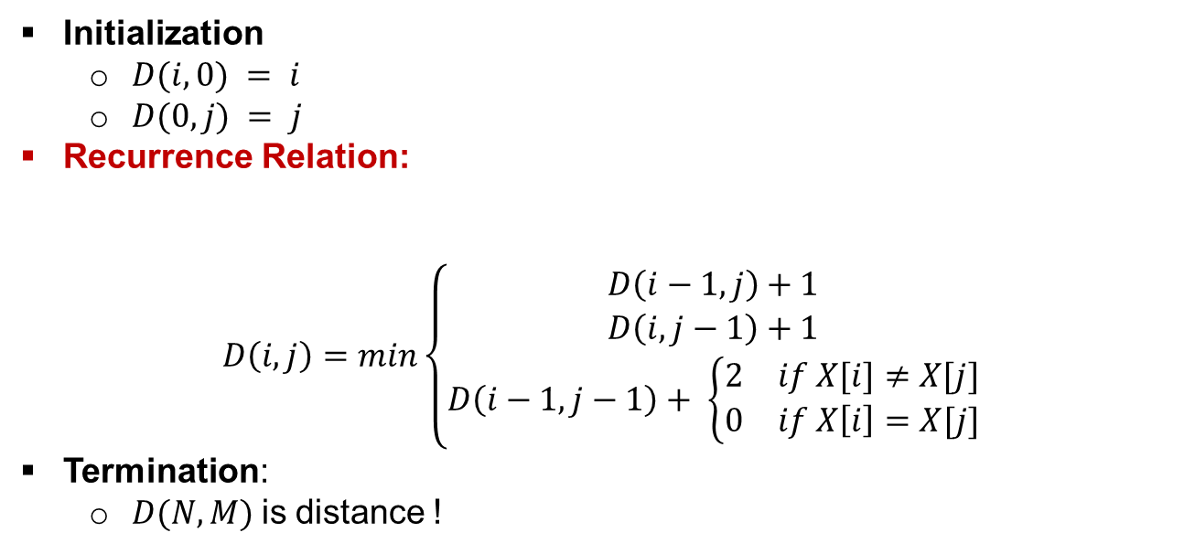
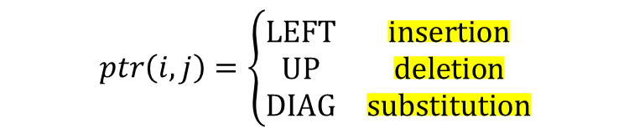
Minimum Edit Distance Problem (Contd.)
Defining Min Edit Distance (Levenshtein) Recursively
Initialization
$D(i, 0) = i$
$D(0, j) = j$
Recurrence Relation:
$$D\left(i, j\right)=min\left\{\begin{matrix}D\left(i−1, j\right)+1 \\ D\left(i, j−1\right)+1 \\ D\left(i−1, j−1\right)+ \left\{\begin{matrix}2 & if X[i]≠X[j] \\ 0 & if X\left[i\right]=X[j]\end{matrix}\right.\end{matrix}\right.$$
Termination:
$D(N, M)$is distance !
deletion
insertion
substitution
$$ptr\left(i, j\right)=\left\{\begin{matrix}LEFT & insertion \\ UP & deletion \\ DIAG & substitution\end{matrix}\right.$$
Topic: MED Problem
Notes:
Initialization:
D(i, 0) = i and D(0, j) = j (These represent transformations involving only insertions or deletions.)
Recurrence Relation:
D(i, j) is the minimum of:
D(i-1, j) + 1 (deletion)
D(i, j-1) + 1 (insertion)
D(i-1, j-1) + 2 if X[i] != Y[j] (substitution)
D(i-1, j-1) if X[i] == Y[j] (no operation)
Termination: The final value of D(n, m) gives the minimum edit distance.

Slide 34
Minimum Edit Distance Problem (Contd.)
The Edit Distance Table
 | # | E | X | E | C | U | T | I | O | N
#
I
N
T
E
N
T
I
O
N
Topic: MED Problem
Notes:
In this slide, we are introduced to the Edit Distance Table used in the Minimum Edit Distance (MED) problem. The table helps in determining the minimum number of operations (insertions, deletions, or substitutions) required to transform one string into another.
Here’s a brief breakdown of the table structure:
Rows represent the characters of the first string (e.g., "INTENTION").
Columns represent the characters of the second string (e.g., "EXECUTION").
The cell values in the table represent the minimum edit distance to convert substrings from the first string to substrings of the second string.

Slide 35
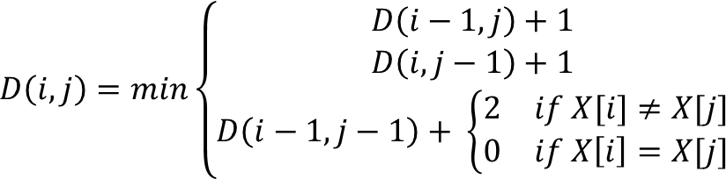
Minimum Edit Distance Problem (Contd.)
The Edit Distance Table
 | # | E | X | E | C | U | T | I | O | N
# | 0 | 1 | 2 | 3 | 4 | 5 | 6 | 7 | 8 | 9
I | 1
N | 2
T | 3
E | 4
N | 5
T | 6
I | 7
O | 8
N | 9
deletion
insertion
substitution
Topic: MED Problem
Notes:
We now begin populating the table, starting with the first row and the first column.
The first row is initialized with values from 0 to the length of the second string, representing the cost of inserting characters.
The first column is initialized with values from 0 to the length of the first string, representing the cost of deleting characters.
Notice the arrow pointing to 1 at position (1,1), which indicates the minimum edit distance when comparing the first characters of both strings.

Slide 36
Minimum Edit Distance Problem (Contd.)
The Edit Distance Table
 | # | E | X | E | C | U | T | I | O | N
# | 0 | 1 | 2 | 3 | 4 | 5 | 6 | 7 | 8 | 9
I | 1 | 2
N | 2
T | 3
E | 4
N | 5
T | 6
I | 7
O | 8
N | 9
deletion
insertion
substitution
Topic: MED Problem
Notes:
In this slide, the table is being filled by considering the cost of each operation at each position.
The value in the cell (i, j) is determined by the minimum of the following three operations:
Deletion: The cost of deleting a character from string 1 (D(i-1,j) + 1).
Insertion: The cost of inserting a character into string 1 (D(i,j-1) + 1).
Substitution: The cost of substituting a character in string 1 with a character from string 2 (D(i-1,j-1) + 2 if the characters don't match, 0 if they do).
As we fill the table, you can see the arrows that represent the direction of the minimum cost.

Slide 37
Minimum Edit Distance Problem (Contd.)
The Edit Distance Table
 | # | E | X | E | C | U | T | I | O | N
# | 0 | 1 | 2 | 3 | 4 | 5 | 6 | 7 | 8 | 9
I | 1 | 2 | 3 | 4 | 5 | 6 | 7
N | 2
T | 3
E | 4
N | 5
T | 6
I | 7
O | 8
N | 9
Topic: MED Problem
Notes:
The table continues to fill by comparing characters from both strings, focusing on minimizing the number of operations. Notice the arrows pointing to different cells based on whether we are performing an insertion, deletion, or substitution.
For instance, at position (2,2), the value represents the minimum of the three operations: deletion, insertion, or substitution. The result gives the smallest edit distance at that point.

Slide 38
Minimum Edit Distance Problem (Contd.)
The Edit Distance Table
 | # | E | X | E | C | U | T | I | O | N
# | 0 | 1 | 2 | 3 | 4 | 5 | 6 | 7 | 8 | 9
I | 1 | 2 | 3 | 4 | 5 | 6 | 7 | 6
N | 2
T | 3
E | 4
N | 5
T | 6
I | 7
O | 8
N | 9
Topic: MED Problem
Notes:
Here, we continue filling the table. In this stage, more comparisons are made, and the cells accumulate the minimum number of operations needed at each step.
As we go further down and across the table, you’ll see that the minimum value (highlighted by arrows) is used to populate the subsequent cells. This iterative approach ensures that each step is optimal.

Slide 39
Minimum Edit Distance Problem (Contd.)
The Edit Distance Table
 | # | E | X | E | C | U | T | I | O | N
# | 0 | 1 | 2 | 3 | 4 | 5 | 6 | 7 | 8 | 9
I | 1 | 2 | 3 | 4 | 5 | 6 | 7 | 6 | 7 | 8
N | 2
T | 3
E | 4
N | 5
T | 6
I | 7
O | 8
N | 9
Topic: MED Problem
Notes:
In this step, we see that the table is almost complete. The last cell (bottom-right) will contain the total minimum edit distance, which tells us the number of operations needed to convert the first string into the second string.
The arrows guide us through the optimal path taken to compute the minimum distance, indicating the operations performed.

Slide 40
Minimum Edit Distance Problem (Contd.)
The Edit Distance Table
 | # | E | X | E | C | U | T | I | O | N
# | 0 | 1 | 2 | 3 | 4 | 5 | 6 | 7 | 8 | 9
I | 1 | 2 | 3 | 4 | 5 | 6 | 7 | 6 | 7 | 8
N | 2 | 3 | 4 | 5 | 6 | 7 | 8 | 7 | 8 | 7
T | 3 | 4 | 5 | 6 | 7 | 8 | 7 | 8 | 9 | 8
E | 4 | 3 | 4 | 5 | 6 | 7 | 8 | 9 | 10 | 9
N | 5 | 4 | 5 | 6 | 7 | 8 | 9 | 10 | 11 | 10
T | 6 | 5 | 6 | 7 | 8 | 9 | 8 | 9 | 10 | 11
I | 7 | 6 | 7 | 8 | 9 | 10 | 9 | 8 | 9 | 10
O | 8 | 7 | 8 | 9 | 10 | 11 | 10 | 9 | 8 | 9
N | 9 | 8 | 9 | 10 | 11 | 12 | 11 | 10 | 9 | 8
Topic: MED Problem
Notes:
This slide shows the fully completed edit distance table. You can now observe the values filled in for every cell, representing the minimum edit distance at each stage of transformation.
The final number in the bottom-right corner of the table represents the total minimum edit distance between the two strings. In this case, it would be 8.

Slide 41
Minimum Edit Distance Problem (Contd.)
The Edit Distance Table
 | # | E | X | E | C | U | T | I | O | N
# | 0 | 1 | 2 | 3 | 4 | 5 | 6 | 7 | 8 | 9
I | 1 | 2 | 3 | 4 | 5 | 6 | 7 | 6 | 7 | 8
N | 2 | 3 | 4 | 5 | 6 | 7 | 8 | 7 | 8 | 7
T | 3 | 4 | 5 | 6 | 7 | 8 | 7 | 8 | 9 | 8
E | 4 | 3 | 4 | 5 | 6 | 7 | 8 | 9 | 10 | 9
N | 5 | 4 | 5 | 6 | 7 | 8 | 9 | 10 | 11 | 10
T | 6 | 5 | 6 | 7 | 8 | 9 | 8 | 9 | 10 | 11
I | 7 | 6 | 7 | 8 | 9 | 10 | 9 | 8 | 9 | 10
O | 8 | 7 | 8 | 9 | 10 | 11 | 10 | 9 | 8 | 9
N | 9 | 8 | 9 | 10 | 11 | 12 | 11 | 10 | 9 | 8
Topic: MED Problem
Notes:
This is the final step where the table is interpreted. The complete table has been filled, and the minimum edit distance between the two strings is obtained by looking at the value in the bottom-right corner of the table.
The arrows in the table represent the most efficient sequence of operations that transform the first string into the second. This dynamic programming approach ensures that we efficiently solve the problem by breaking it down into smaller subproblems and reusing the results.

Slide 42
Summary
String matching is an integral part of many important applications.
Both LCS and MED problems can be solved efficiently using dynamic programming.
Topic: Pattern Matching Algorithms
Notes:
String Matching Applications:
String matching is crucial for many real-world applications such as text search, bioinformatics (sequence alignment), spell checking, machine translation, and more.
It plays an important role in various computational fields, including natural language processing and computational biology.
Efficiency of Dynamic Programming in Solving LCS and MED:
Both the Longest Common Subsequence (LCS) problem and the Minimum Edit Distance (MED) problem are fundamental string matching problems.
These problems are efficiently solved using dynamic programming, which ensures an optimal solution by breaking down the problem into smaller subproblems and storing their results for reuse.
DP significantly reduces the time complexity compared to brute-force methods, making it a powerful tool in solving string matching and alignment problems.

